Slide 1
TOPICS:
Computer Organization and Architecture
Basic Computer Organization: Instruction Codes, Computer Registers, Computer Instructions

Slide 2
Instruction Codes

Slide 3
Instruction Codes
The organization of the computer is defined by its internal registers, the timing and control structure, and the set of instructions that it uses.
A computer instruction is a binary code that specifies a sequence of micro-operations for the computer.
An instruction code is a group of bits that instruct the computer to perform a specific operation.
Instruction code is usually divided into two parts.
Operation part - Group of bits that define such operations as add, subtract, multiply, shift, and complement.
Address part - Contains registers or memory words where the address of operand is found or the result is to be stored.
Each computer has its own instruction code format.

Slide 4
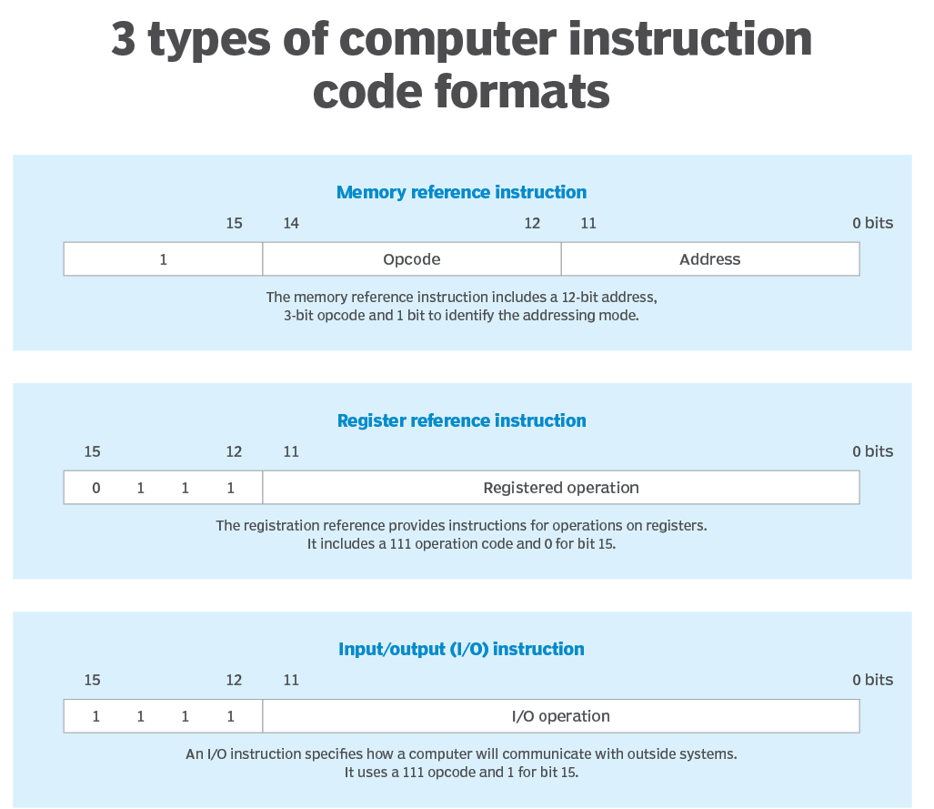

Slide 5
Operation Code
The operation code (op-code) of an instruction is a group of bits that define such operations as add, subtract, multiply, shift, and complement.
The number of bits required for the operation code of an instruction depends on the total number of operations available in the computer (n bits for 2^{n} operations).
An operation code is sometimes called a macro-operation because it specifies a set of micro-operations.

Slide 6
Stored Program Organization
Simplest way to organize computer is to have one processor register(Accumulator AC) and an instruction code format with two parts:
First-Operation to be performed
Second – Address
The memory address tells the control where to find an operand in memory.
This operand is read from memory and used as the data to be operated on together with the data stored in the processor register.

Slide 7
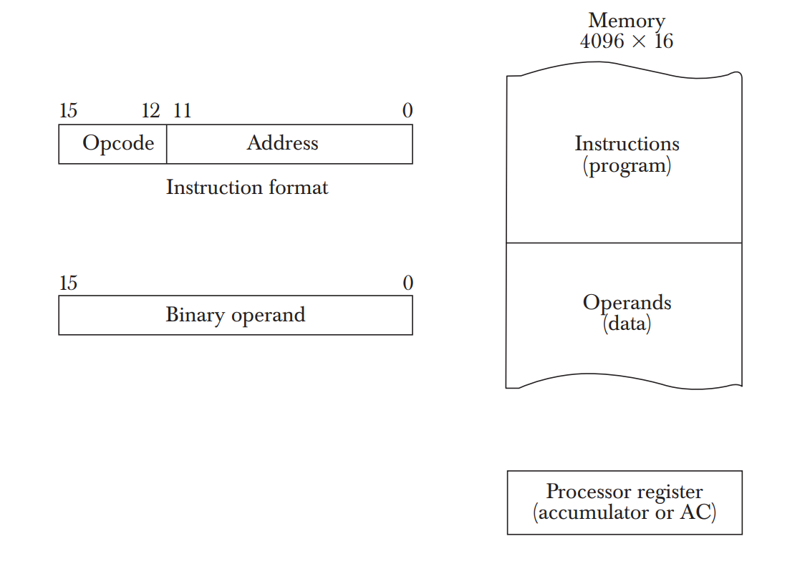
Stored Program Organization
Instructions are stored in one section of the memory and data in another.
For a memory unit with 4096 words we need 12 bits to specify an address since 2¹²=4096.
4 bits are available for opcode to specify one out of 16 possible operations.

Slide 8
Steps
The control reads a 16-bit instruction from the program portion of memory.
It uses the 12-bit address part of the instruction to read a 16-bit operand from the data portion of memory.
It then executes the operation specified by the operation code.
The operation is performed with the memory operand and the content of AC.

Slide 9
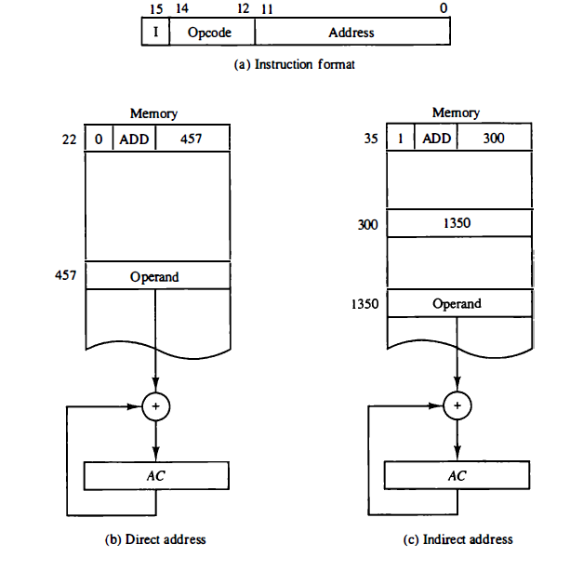
Direct and Indirect Addressing Modes
Following Addressing Modes are used for address portion of the instruction code.
Immediate- The address part specifies an operand. Eg: ADD 5
Direct- The address part specifies the address of an operand.
Indirect- The address part specifies a pointer(another address) where the address of the operand can be found.
One bit of the instruction code(I) can be used to distinguish between a direct and an indirect address.

Slide 10
Effective Address
It is the address of the operand in a computation-type instruction or the target address in a branch-type instruction.
The effective address in the instruction of the figures are 457 and 1350.

Slide 11
Computer Registers

Slide 12
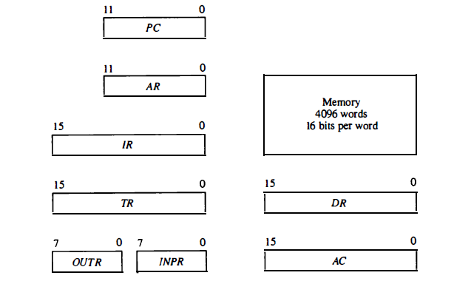
Basic Computer Registers and Memory

Slide 13
Computer Registers
Need of Registers?
Computer instructions are normally stored in consecutive memory locations and are executed sequentially one at a time.
The control reads an instruction from a specific address in memory and executes it. It then continues by reading the next instruction in sequence and executes it, and so on.
This type of instruction sequencing needs a counter to calculate the address of the next instruction after execution of the current instruction is completed.
It is also necessary to provide a register in the control unit for storing the instruction code after it is read from memory.
The computer needs processor registers for manipulating data and a register for holding a memory address.

Slide 14
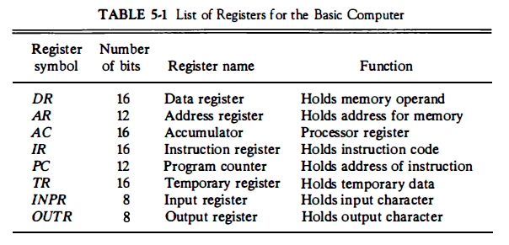
List of Registers for Basic Computer

Slide 15
Common Bus System
Need of Common Bus System ?
The basic computer has eight registers, a memory unit, and a control unit.
Paths must be provided to transfer information from one register to another and between memory and registers.
The number of wires will be excessive if connections are made between the outputs of each register and the inputs of the other registers.
Hence more efficient scheme with a common bus is used.

Slide 16
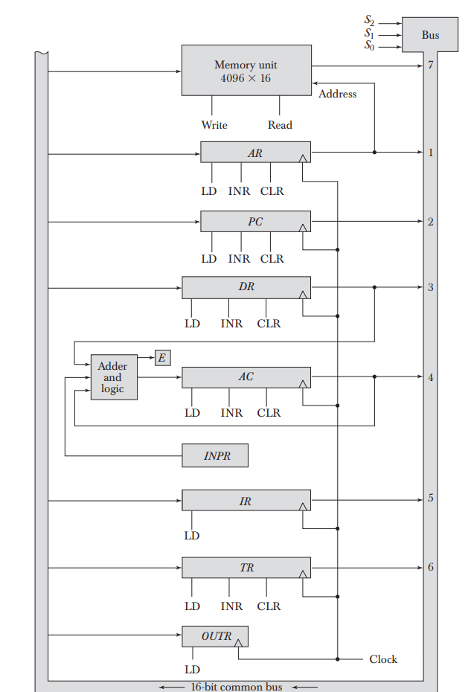
Common Bus System
The outputs of seven registers and memory are connected to the common bus.
The specific output that is selected for the bus lines at any given time is determined from the binary value of the selection variables S₂, S₁, and S₀.
The number along each output shows the decimal equivalent of the required binary selection.
For example, the number along the output of DR is 3. The 16-bit outputs of DR are placed on the bus lines when S₂S₁S₀ =011 since this is the binary value of decimal 3.

Slide 17
Common Bus System
The lines from the common bus are connected to the inputs of each register and the data inputs of the memory.
The particular register whose LD (load) input is enabled receives the data from the bus during the next clock pulse transition.
The memory receives the contents of the bus when its write input is activated.
The memory places its 16-bit output onto the bus when the read input is activated and S₂S₁S₀ =111.

Slide 18
Common Bus System
INPR is connected to provide information to the bus but OUTR can only receive information from the bus.
This is because INPR receives a character from an input device which is then transferred to AC.
OUTR receives a character from AC and delivers it to an output device.
There is no transfer from OUTR to any of the other registers.

Slide 19
Common Bus System
The inputs of AC come from an adder and logic circuit.
This circuit has three sets of inputs.
One set of 16-bit inputs come from the outputs of AC. They are used to implement register micro-operations such as complement AC and shift AC.
Another set of 16-bit inputs come from the data register DR. The inputs from DR and AC are used for arithmetic and logic micro-operations.
A third set of 8-bit inputs come from the input register INPR.

Slide 20
Computer Instructions

Slide 21
Instruction Format
The basic computer has three instruction code formats each having 16 bits:
Memory reference instructions
Register reference instructions
I/O instructions
The opcode part of the instruction contains three bits and the meaning of the remaining 13 bits depends on the operation code encountered.

Slide 22

Memory Reference Instructions
Bits 0-11 for specifying address.
Bits 12-14 for specifying address.
15th bit specifies addressing modes. (0 for direct and 1 for indirect)
Opcode = 000 through 110
I=0 or 1
Eg:
AND - 0xxx(direct) or 8xxx(indirect)
ADD - 1xxx or 9xxx

Slide 23

Register Reference Instructions
Recognized by the operation code 111 with a 0 in the 15th bit of the instruction.
Specifies an operation on or a test of the AC register.
An operand from memory is not needed.
Therefore the 12 bits are used to specify the operation to be executed.
Eg:
CLA - 7800 : Clear AC
CLE - 7400 : Clear E

Slide 24

Input-Output Instructions
These instructions are needed for transferring information to and from AC register.
Recognized by the opcode 111 and a 1 in the 15th bit.
Bits 0-11 specify the type of I/O Operation performed.
Eg:
INP - F800 : Input characters to AC
OUT - F400 : Output characters from AC

Slide 25
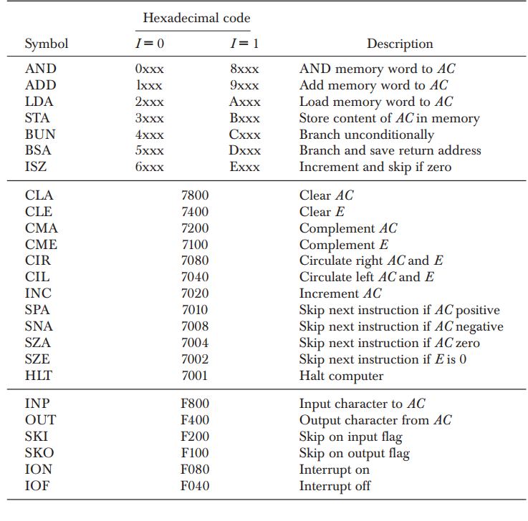
Basic Computer Instructions
The first seven instructions will be carried on accumulator or carry bit, E bit. the next 4 skip instructions will add one to PC register only if their condition is met. Those conditions will be Accumulator is positive, A15=0 Accumulator is negative, A15=1, Accumulator is zero,
A0 to A15 are zero, E is 0, carry bit is zero.

Slide 26
Instruction Set Completeness
The set of instructions are said to be complete if the computer includes a sufficient number of instructions in each of the following categories:
Arithmetic, logical, and shift instructions.
Instructions for moving information to and from memory and processor registers.
Program control instructions.
Input and output instructions.

Slide 27
Input Output & Interrupts •
Computer must communicate with external device to receive and send data with it. •
Instructions and data must come to computer from external input device. Computational result must be transmitted to user through an output device.
Input Output Configuration
The terminal sends and receives 8 bit data converted to serial information and receives serial information and convert it back to parallel 8 bits. The serial info from the keyboard is received serially and shifted into INPR.
The serial info for the printer is stored in the OUTR and converted to serial and sends to the printer.

Slide 28
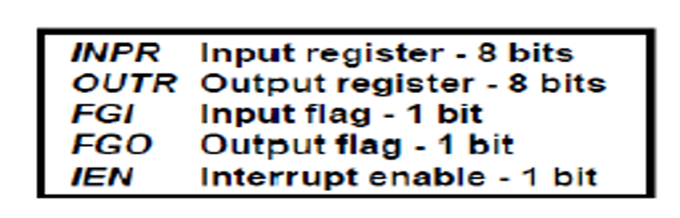
The 1 bit FGI is a control flip flop that sets to 1 when new data is available in input device and cleared to m0 (by processor) when computer receives it (needed to synchronize time difference between processor and input device).
When key is pressed in keyboard its code is shifted to serial and shifted to INPR and FGI is set (by the device). This insures that data in INPR will be untouched by another key pressed till it’s cleared by the processor.
First the FGO is set to 1 (usually by the device) and processor scans that flag. If FGO is 1 then it will transfer AC to OUTR and clears FGO to 0. The output device accepts data in OUTR and sets FGO to 1 indicating it ready for another transfer.

Slide 29
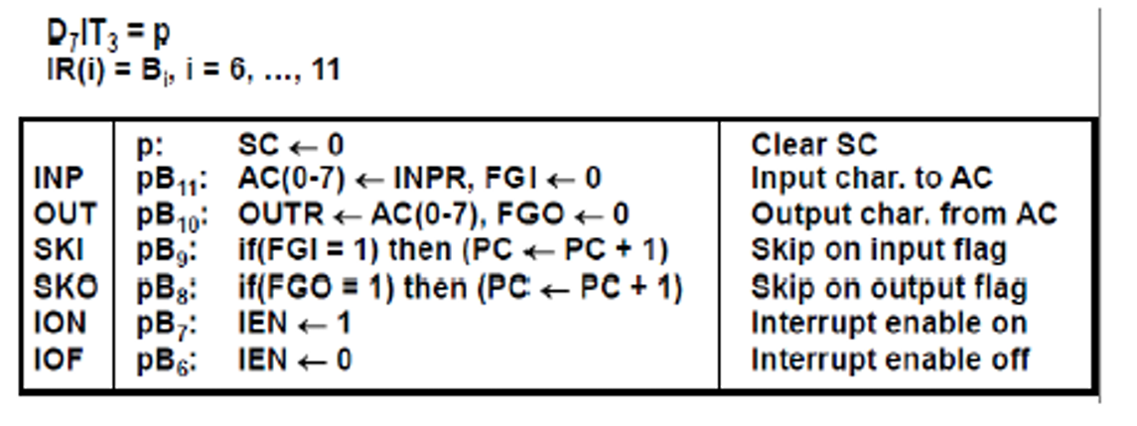
INP instruction transfer data from INPR register to AC0 to AC7 and clears FGI=0
OUT instruction transfers AC0 to AC7 to OUTR and clears FGO=0
The next 2 instructions scans flags and skip next instruction if flag=1 (usually designed for branching to different locations in program based on value of FGI or FGI flags).
The last 2 instructions sets and clear Interrupt Enable flip flop

